Slide 1

Battle of neighbourhoods

Slide 2
Introduction to the project: Battle of neighbourhoods
A description of the problem and a discussion of the background
Problem: A group of stakeholders had recruited me to find and suggest a best place to start a Restaurant/hotel in the capital of Tamil Nadu, India. This problem revolves around gathering information about that city's geographical information and also collecting information about existing hotels in the given area which is a great factor that affects the current problem. The group of stakeholders are from a startup company so they need the result to give the needs according to that.
Disscussion of the background: The group of stakeholders are from a starup hence, their scale is a small-scale. Hence we have to collect the data of the neighbourhoods of the chennai city and their co-ordinates of each neighbourhoods. Also aqcuiring the data of the existing hotels which can be accomplished by using foursquare service. We need to combine all these data and choose a methodology to process the data and to get the result.
It is clear that the data required for this problem must contain maxiumum number of neighbourhood in the chennai city and we should get their co-ordinates in order to locate them on the map model using a module on python called follium and the existing hotels/restaurants in the city and that can be obtained from the foursquare services
A description of the data and how it will be used to solve the problem.
In this problem we can acquire the data of the neighbourhoods of the chennai city and also, each one of their co-ordinates are given in the link https://krishblazer.000webhostapp.com/ which makes our job little easy. We can use this link to scrape the data from the page using beautifulsoup and parse it according to our needs and use pandas to create a dataset and follium to mark the scraped in the map
Foursquare will help us to get the crucial places like the hotels and popular places that people visit so that they might need the food and as we are going to deploy hotels that data is essential for more accurate result.
Let us start by installing and importing the nessessary Libraries and modules

Slide 3
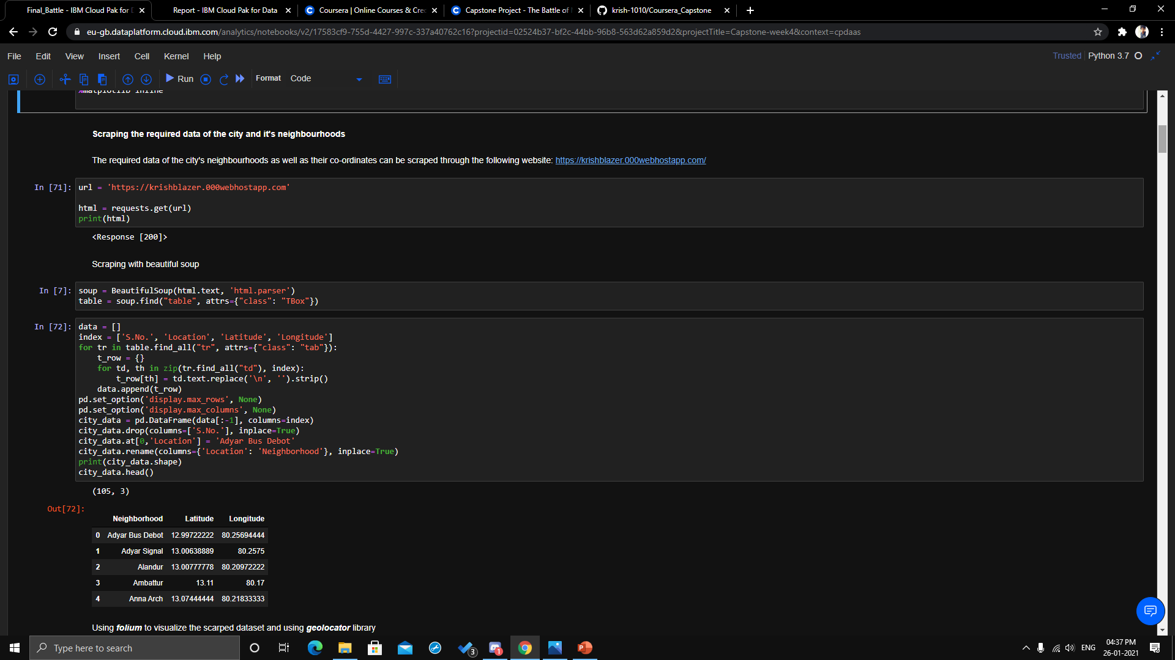
SCRAPING

Slide 4
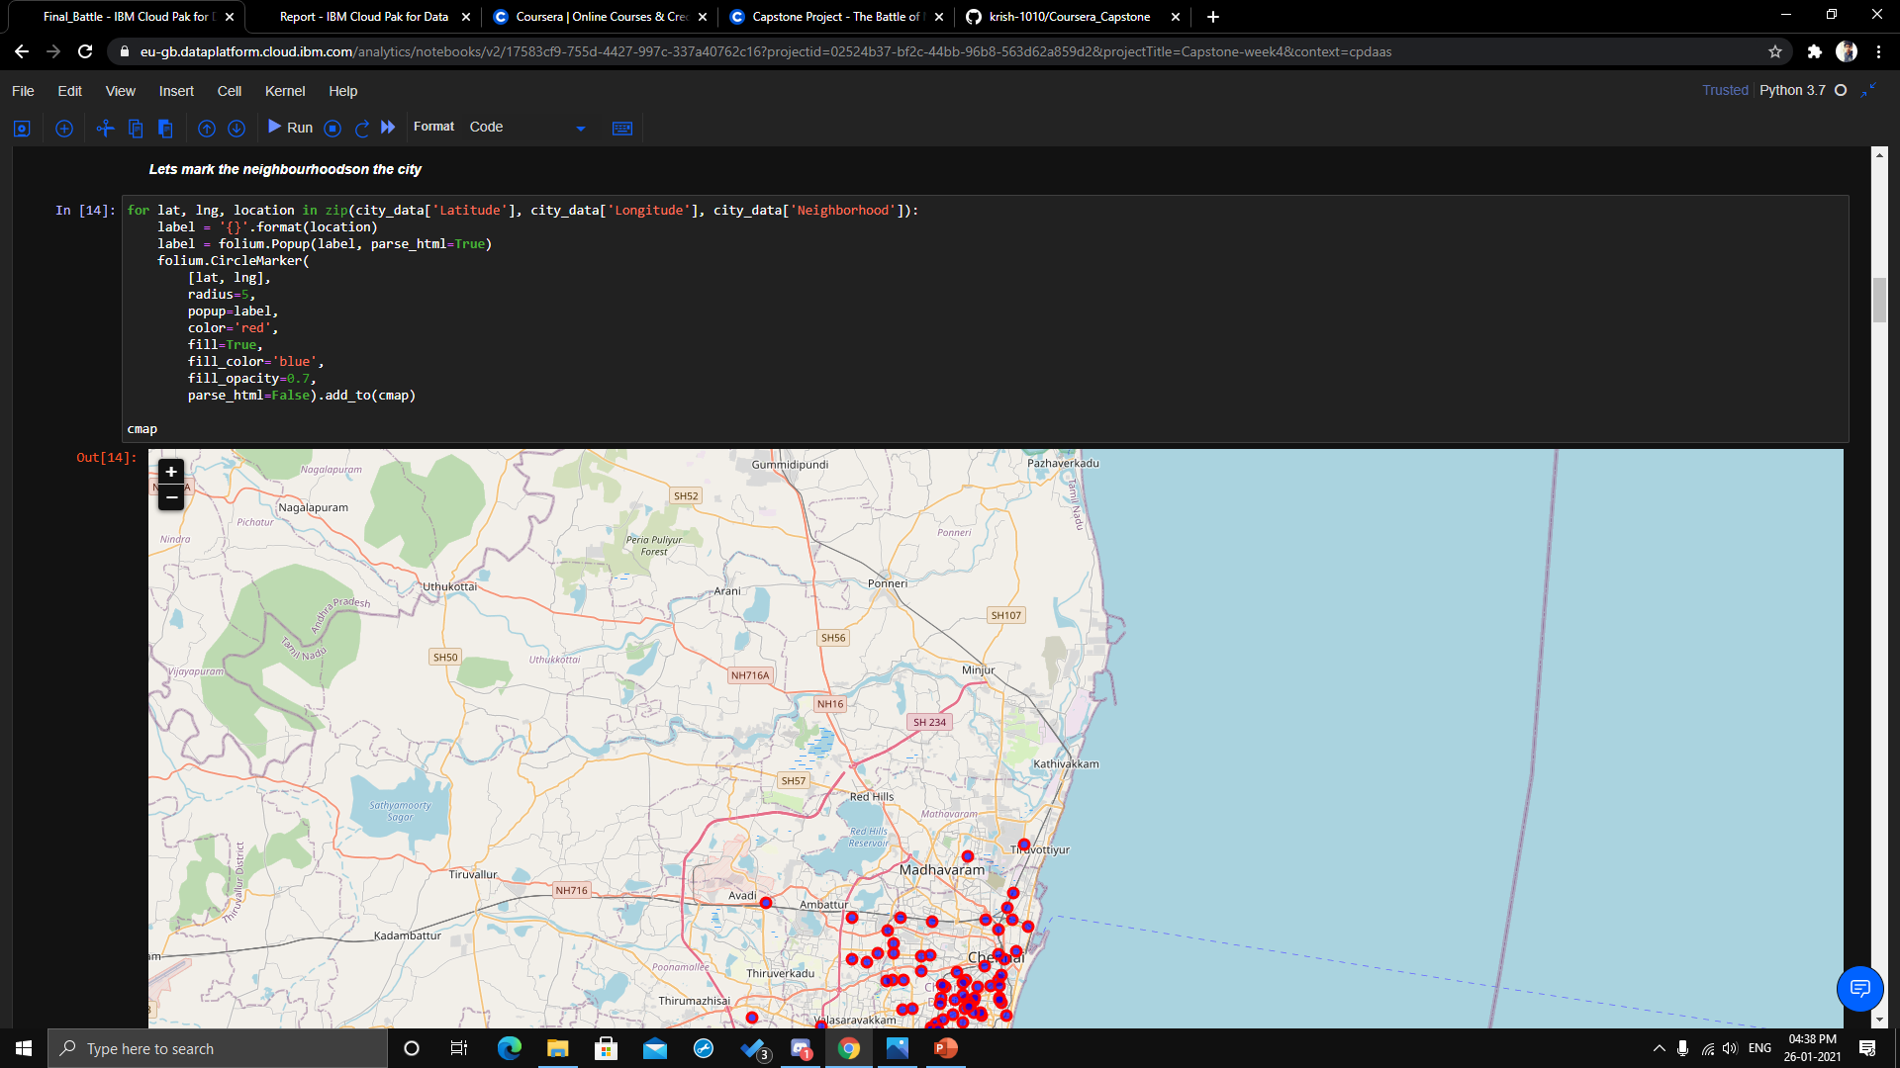
MAPPING

Slide 5
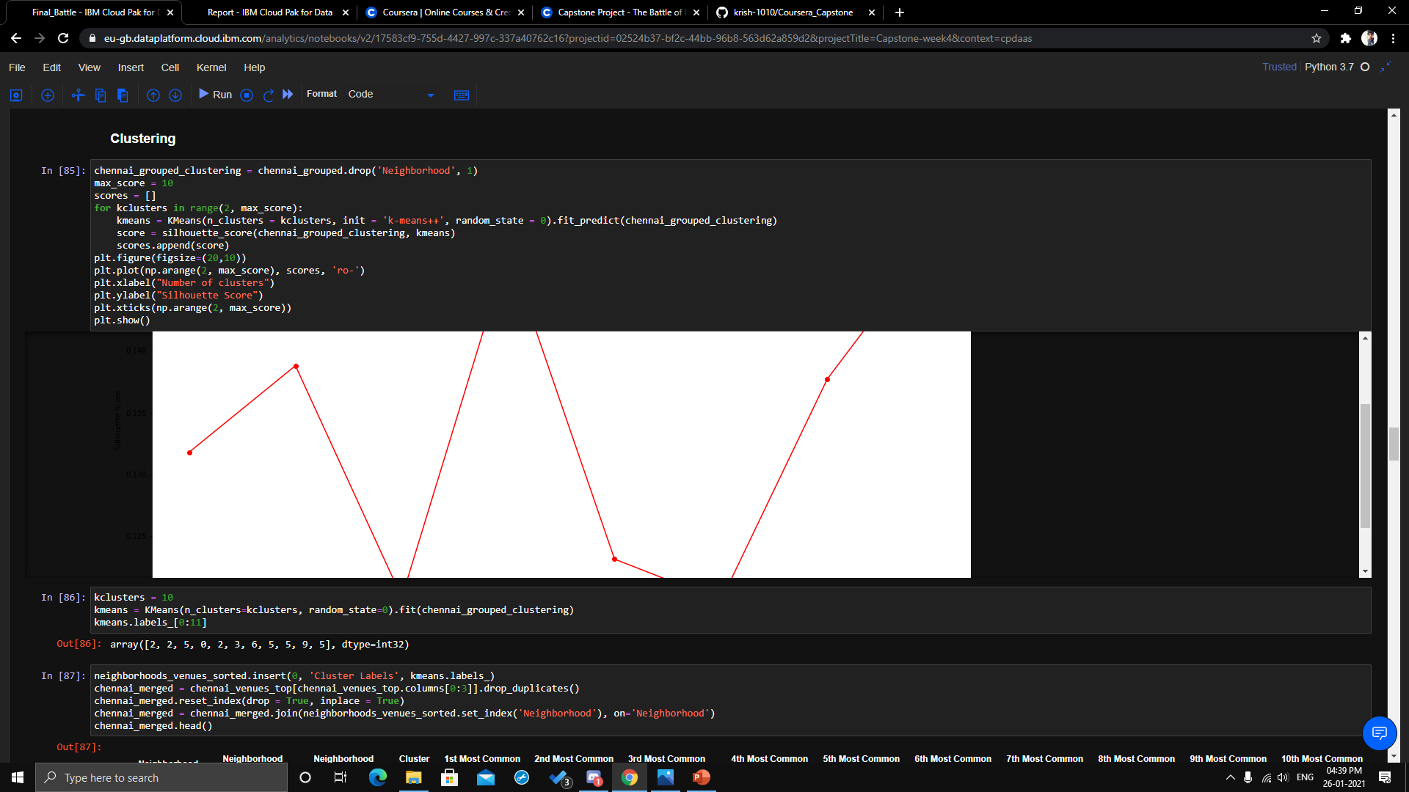
CLUSTERING

Slide 6
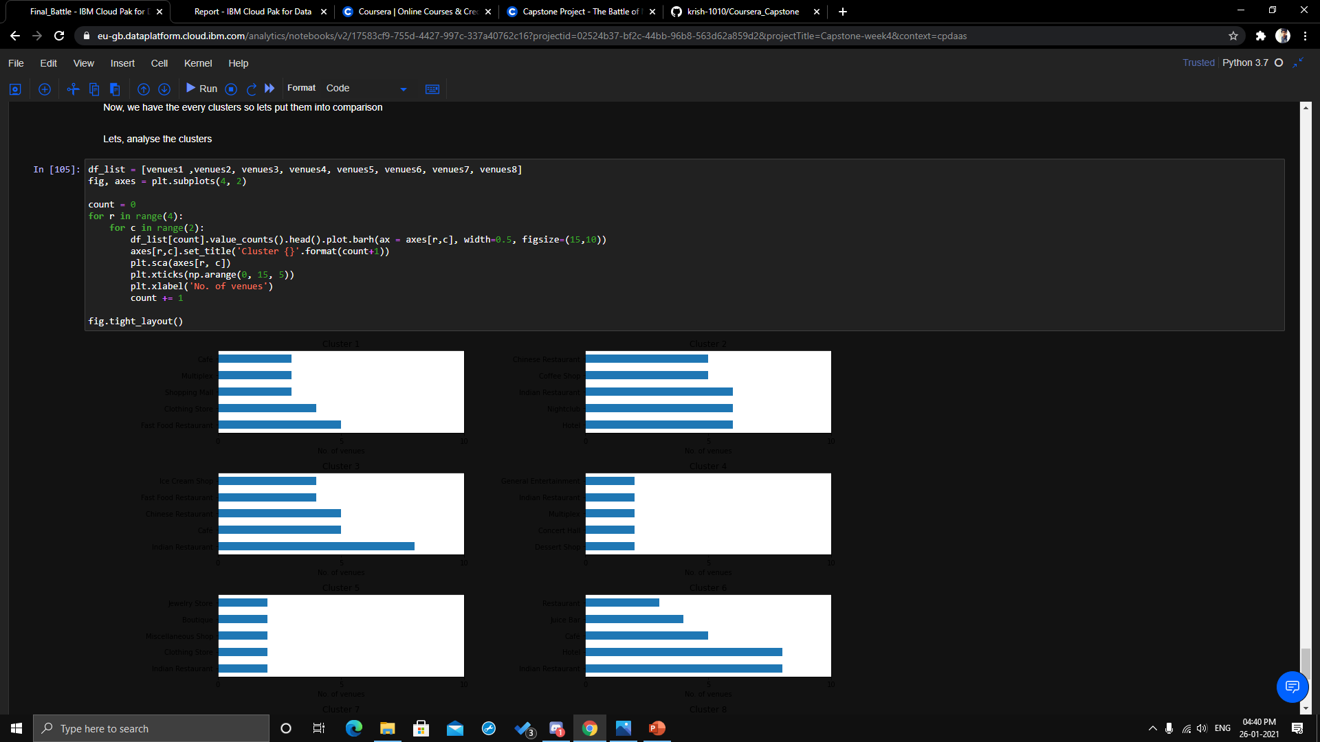

Slide 7
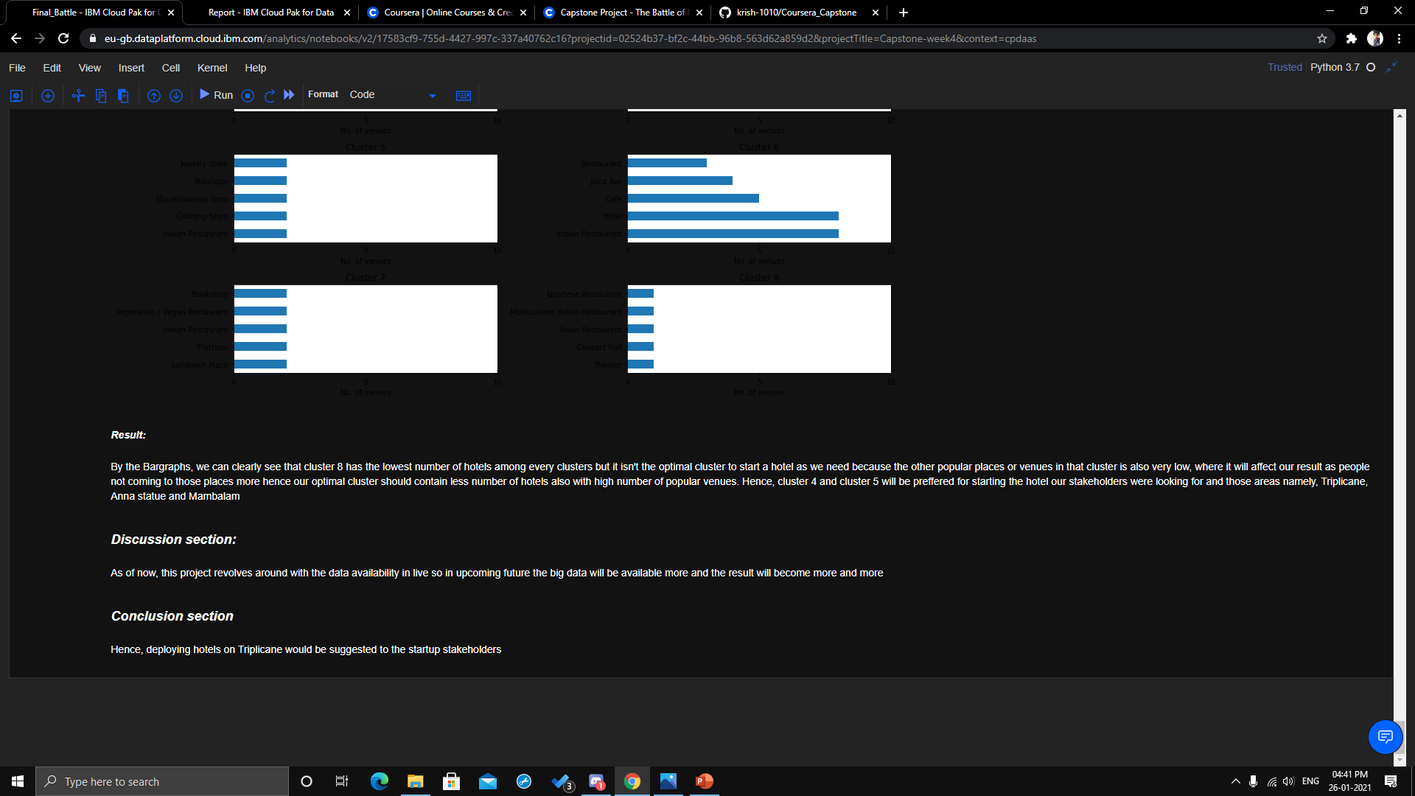
RESULT:

Slide 8

Thank You
.

